Slide 1

Transportation Problem using Vogul’s Approximation Method

Slide 2
Transportation Problem
The transportation problem is a type of linear programming problem where the goal is to determine the most cost-effective way to transport goods from multiple sources (e.g., factories) to multiple destinations (e.g., warehouses) while satisfying supply and demand constraints. The objective is to minimize the total transportation cost while meeting all the supply and demand requirements.

Slide 3
Warehouse
A
250
Factories
3
300
1
1
7
B
350
4
2
6
400
2
5
9
C
400
8
3
3
500
3
2
D
200

Slide 4
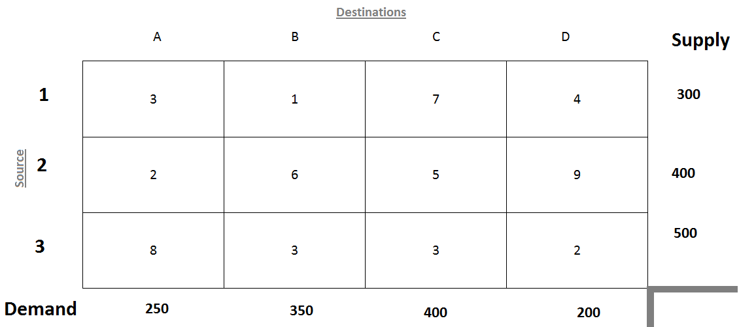
(Warehouses)
(Factories)

Slide 6
Basic Steps
Step 1: Get an initial feasible solution with VAM.
Step 2: Test of degeneracy
Step 3: Testing the Optimality Solution
Step 3.1: Calculation of Row Values and Column values for occupied cells.
Step 3.2: Calculation of improvement indices for unoccupied cells.

Slide 7
Basic Steps
Step 1: Get an initial feasible solution with VAM.
Step 2: Test of degeneracy
Step 3: Testing the Optimality Solution
Step 3.1: Calculation of Row Values and Column values for occupied cells.
Step 3.2: Calculation of improvement indices for unoccupied cells.

Slide 8
Check if the given transportation problem is balanced or not,
by calculating total demand and total supply capacity,
and compare with each other.

Slide 9
Total Supply = 300+400+500=1200
Total Demand = 250+350+400+200 = 1200

Slide 10
Here, total demand = total supply = 1200
Since Demand and Supply are equal, this is a balanced transportation problem.

Slide 11
Steps to Implement VAM:
Calculate Row and Column Penalties:
For each row and column in the transportation table, calculate the penalty. The penalty is the difference between the smallest and the second smallest costs in that row or column.
Select the Highest Penalty:
Identify the row or column with the highest penalty. This indicates the route where the cost difference is the most significant, meaning that not choosing the least-cost route here would result in a higher penalty.
Allocate to the Least Cost in the Chosen Row/Column:
In the row or column with the highest penalty, allocate as much as possible to the cell with the least cost.
Adjust Supply and Demand:
Adjust the supply and demand for the row and column where the allocation was made. If the supply is exhausted, remove that row; if the demand is met, remove that column.
Repeat the Process:
Repeat the process until all supplies and demands are satisfied.

Slide 12
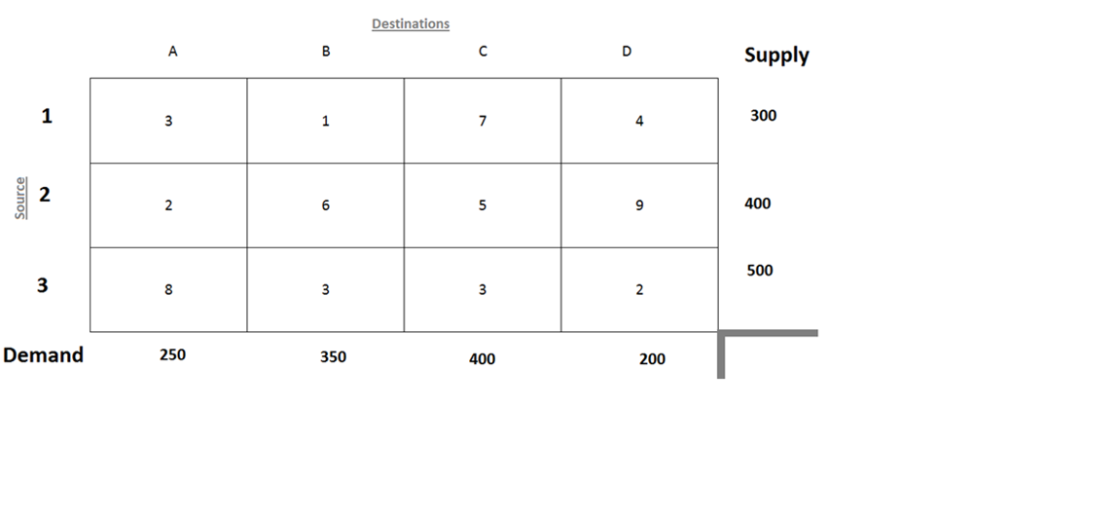
Row Difference
2
3
1
Column Difference

Slide 13
Row Difference
2
3
1
1
2
2
2
Column Difference

Slide 14

Row Difference
2
150
3
1
0
1
2
2
2
Column Difference

Slide 15
Row Difference
2
3
150
3
1
1
1
0
1
2
2
2
Column Difference

Slide 16
Row Difference
2
3
150
3
1
1
1
0
1
2
2
2
Column Difference
2
2
2

Slide 17

Row Difference
0
2
3
150
3
1
1
1
0
50
1
2
2
2
Column Difference
2
2
2

Slide 18
Row Difference
0
2
3
150
3
1
1
1
1
1
0
50
1
2
2
2
Column Difference
2
2
2

Slide 19
Row Difference
0
2
3
150
3
1
1
1
1
1
0
50
1
2
2
2
Column Difference
2
2
2
3
2
7

Slide 20
Row Difference
0
2
3
150
3
1
1
1
1
1
300
0
50
0
1
2
2
2
Column Difference
2
2
2
3
2
7

Slide 21
Row Difference
0
2
3
150
3
1
1
1
1
1
1
0
300
0
50
0
1
2
2
2
Column Difference
2
2
2
3
2
7

Slide 22
Row Difference
0
2
3
150
3
1
1
1
1
1
1
0
300
0
50
0
1
2
2
2
Column Difference
2
2
2
3
2
7
3
2

Slide 23

Row Difference
0
2
3
150
3
1
1
1
1
1
1
0
300
250
0
50
0
0
1
2
2
2
Column Difference
2
2
2
3
2
7
3
2

Slide 24

Row Difference
0
2
3
150
3
1
1
1
1
1
1
300
250
0
0
50
150
0
0
1
2
2
2
Column Difference
2
2
2
3
2
7
3
2

Slide 25

Row Difference
0
2
3
0
150
3
1
1
1
1
1
1
300
250
0
0
50
150
0
0
0
1
2
2
2
Column Difference
2
2
2
3
2
7
3
2

Slide 26
300*1
+150*5
+50*3
+250*3
=2850
+ 250*2
+200*2
Row Difference
0
2
3
0
150
3
1
1
1
1
1
1
300
250
0
0
50
150
0
0
0
1
2
2
2
Column Difference
2
2
2
3
2
7
3
2

Slide 27
Initial Transportation Cost
300*1
+150*5
+50*3
+250*3
=2850
+ 250*2
+200*2

Slide 28
Step 1: Get an initial feasible solution
Step 2: Test of degeneracy
Step 3: Testing the Optimality Solution
Step 3.1: Calculation of Row Values and Column values for occupied cells.
Step 3.2: Calculation of improvement indices for unoccupied cells.

Slide 29
Test of Degeneracy
M – Number of Rows
N – Number of Columns
M + N – 1 = 3 + 4 – 1 = 6
Number of Occupied Cells = 6
Since, M+N-1 = Occupied Cells = 6, this is the case of non-degeneracy.

Slide 30
Step 1: Get an initial feasible solution
Step 2: Test of degeneracy
Step 3: Testing the Optimality Solution
Step 3.1: Calculation of Row Values and Column values for occupied cells.
Step 3.2: Calculation of improvement indices for unoccupied cells.

Slide 31

Step 1: Get an initial feasible solution
Step 2: Test of degeneracy
Step 3: Testing the Optimality Solution
Step 3.1: Calculation of Row Values and Column values for occupied cells.
Step 3.2: Calculation of improvement indices for unoccupied cells.

Slide 32
Calculation of Row Values and Column values for occupied cells using C_{ij} = U_{i} + V_{j}.

Slide 33
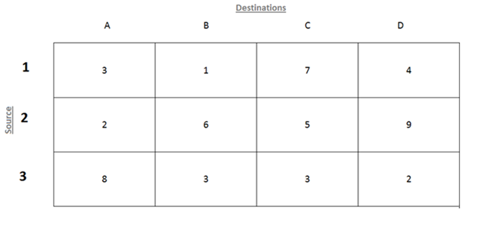
U₁
1,1
1,2
1,3
1,4
U₂
2,1
2,2
2,3
2,4
U₃
3,1
3,2
3,3
3,4
V₁
V₂
V₃
V₄
C_{ij} = U_{i} + V_{j}
C₁₂ = U₁ + V₂
C₂₁ = U₂ + V₁
C₂₃ = U₂ + V₃
C₃₂ = U₃ + V₂
C₃₃ = U₃ + V₃
C₃₄ = U₃ + V₄

Slide 34
U₁
U₂
U₃
V₁
V₂
V₃
V₄
C_{ij} = U_{i} + V_{j}
C₁₂ = U₁ + V₂
C₂₁ = U₂ + V₁
C₂₃ = U₂ + V₃
C₃₂ = U₃ + V₂
C₃₃ = U₃ + V₃
C₃₄ = U₃ + V₄

Slide 35
Let U₁ = 0
U₂
U₃
V₁
V₂
V₃
V₄
C_{ij} = U_{i} + V_{j}
C₁₂ = U₁ + V₂
1 = 0 + V₂
V₂ = 1
C₂₁ = U₂ + V₁
2 = 4 + V₁
V₁ = -2
C₂₃ = U₂ + V₃
5 = U₂ + 1
U₂ = 4
C₃₂ = U₃ + V₂
3 = U₃ + 1
U₃ = 2
C₃₃ = U₃ + V₃
3 = 2 + V₃
V₃ = 1
C₃₄ = U₃ + V₄
2 = 2 + V₄
V₄ = 0

Slide 36
U₁ = 0
U₂ = 4
U₃ = 2
V₁ = -2
V₂ = 1
V₃ = 1
V₄ = 0
C_{ij} = U_{i} + V_{j}
C₁₂ = U₁ + V₂
1 = 0 + V₂
V₂ = 1
C₂₁ = U₂ + V₁
2 = 4 + V₁
V₁ = -2
C₂₃ = U₂ + V₃
5 = U₂ + 1
U₂ = 4
C₃₂ = U₃ + V₂
3 = U₃ + 1
U₃ = 2
C₃₃ = U₃ + V₃
3 = 2 + V₃
V₃ = 1
C₃₄ = U₃ + V₄
2 = 2 + V₄
V₄ = 0

Slide 38
Step 1: Get an initial feasible solution
Step 2: Test of degeneracy
Step 3: Testing the Optimality Solution
Step 3.1: Calculation of Row Values and Column values for occupied cells.
Step 3.2: Calculation of improvement indices for unoccupied cells.

Slide 39
Δ_{ij} = C_{ij} - U_{i} - V_{j}

Slide 42
U₁ = 0
U₂ = 4
U₃ = 2
V₁ = -2
V₂ = 1
V₃ = 1
V₄ = 0
Δ_{ij} = C_{ij} – U_{i} - V_{j}
Δ₁₁ = C₁₁ – U₁ – V₁
Δ₁₁ = 3 – 0 – (-2) = 5
Δ₁₁ = 5
Δ₁₃ = C₁₃ – U₁ – V₃
Δ₁₃ = 7 – 0 – 1 = 6
Δ₁₃ = 6
Δ₁₄ = C₁₄ – U₁ – V₄
Δ₁₄ = 4 – 0 – 0 = 4
Δ₁₄ = 4
Δ₂₂ = C₂₂ – U₂ – V₂
Δ₂₂ = 6 – 4 – 1 = 1
Δ₂₂ = 1
Δ₂₄ = C₂₄ – U₂ – V₄
Δ₂₄ = 9 – 4 – 0 = 5
Δ₂₄ = 5
Δ₃₁ = C₃₁ – U₃ – V₁
Δ₃₁ = 8 – 2 – (-2) = 8
Δ₃₁ = 8

Slide 43
U₁ = 0
U₂ = 4
U₃ = 2
V₁ = -2
V₂ = 1
V₃ = 1
V₄ = 0
Since all Δ_{ij} ≥ 0, the optimal solution has been obtained. It means the initial transportation cost calculated of Rs 2850 is optimal.
Δ_{ij} = C_{ij} – U_{i} - V_{j}
Δ₁₁ = C₁₁ – U₁ – V₁
Δ₁₁ = 3 – 0 – (-2) = 5
Δ₁₁ = 5
Δ₁₃ = C₁₃ – U₁ – V₃
Δ₁₃ = 7 – 0 – 1 = 6
Δ₁₃ = 6
Δ₁₄ = C₁₄ – U₁ – V₄
Δ₁₄ = 4 – 0 – 0 = 4
Δ₁₄ = 4
Δ₂₂ = C₂₂ – U₂ – V₂
Δ₂₂ = 6 – 4 – 1 = 1
Δ₂₂ = 1
Δ₂₄ = C₂₄ – U₂ – V₄
Δ₂₄ = 9 – 4 – 0 = 5
Δ₂₄ = 5
Δ₃₁ = C₃₁ – U₃ – V₁
Δ₃₁ = 8 – 2 – (-2) = 8
Δ₃₁ = 8

Slide 45
Step 1: Get an initial feasible solution
Step 2: Test of degeneracy
Step 3: Testing the Optimality Solution
Step 3.1: Calculation of Row Values and Column values for occupied cells.
Step 3.2: Calculation of improvement indices for unoccupied cells.

